Slide 1
Using Technology with Patients

Slide 2
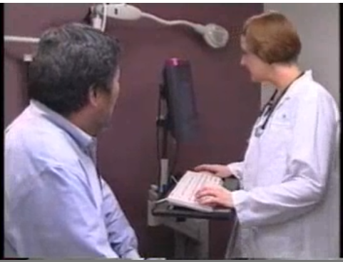
What is wrong with this encounter?
http://www.youtube.com/watch?v=ezQb2AT0FZU
Notes:
All current medical students will use an EMR in their future practice. Assuming that your goal for using an EMR in practice will be to improve safety while having all patient charts in a form that will make them more transportable, reportable, accurate and legible. Also, the EMR should eventually improve your productivity, so that you can complete all your documentation while seeing the patient instead of having to do it after you see the patient. There are a number of impacts that use of technology in the patient encounter can have on communication. What is wrong with this encounter.

Slide 3
CLC Checklist for Good Patient Communication
Introduce self
Establish rapport
Open ended questions at beginning
Maintain good eye contact
Be supportive and concerned
Used transitional statements
Avoid using medical jargon
Allow patient to speak without interruption
Summarize history
Gave patient a chance to ask questions
Appear poised, professional, confident
How can an Electronic Medical Record (EMR)
adversely effect patient communication?
Notes:
We spend the first two years in the clinical learning center teaching students how to interact with patients, building rapport and trust, in a professional yet patient centered manner.

Slide 4
Possible Adverse Effects
Computer creates barrier between doctor or student and patient
Poor eye contact
Closed ended questions driven by templates
Missing teaching moments
Pauses while typing/looking for patient education not engaged with patient
What specific actions can we take to avoid these situations?
Notes:
All of these adverse effects have been identified in the literature. Lets look at one thing– the room arrangement…

Slide 5
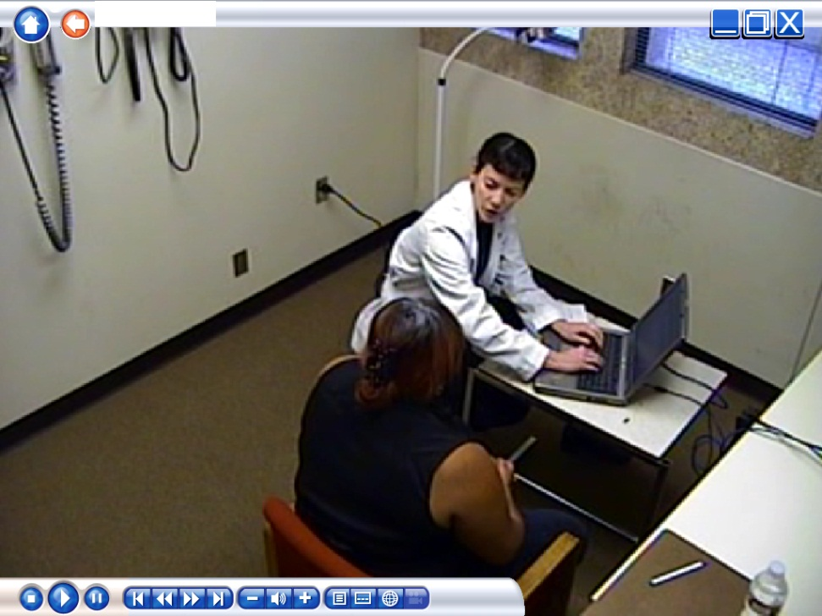
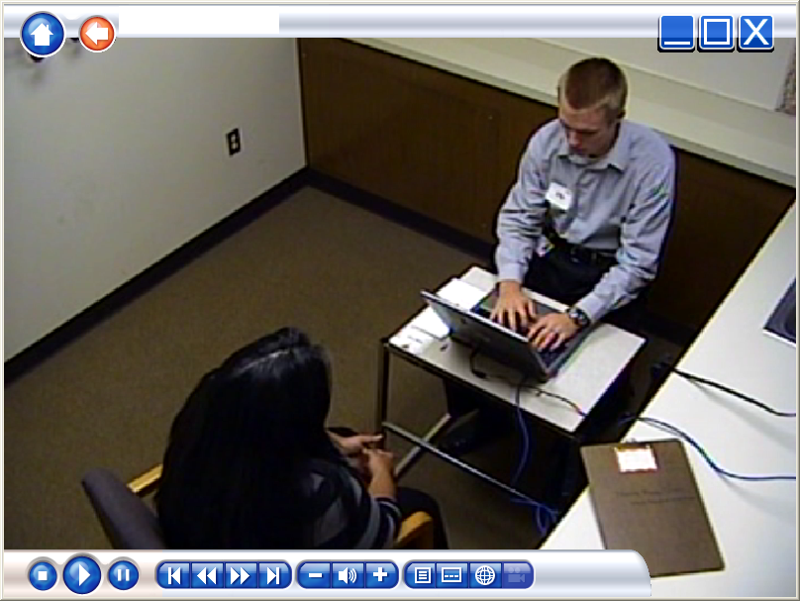
Arranging the Exam Room
Which of these is best? Why?
Notes:
We don’t expect that you will be able to do anything about the room arrangement of your clinical faculty’s clinic. However, in case you do have a say in your own clinic set up, or are using a portable computer,…

Slide 6
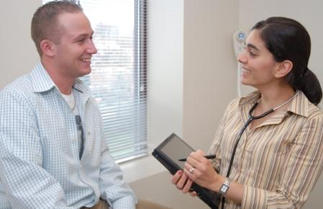
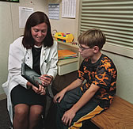
Using Tablets (iPads)
Advantages? Disadvantages?
Notes:
Have a discussion of what you can do with a tablet.

Slide 7
Using Mobile Devices with Patients
Message given to students on using technology with patients.
Patients think you are texting or taking photos
Reassure patient you are not
Tell the patient what you are doing (looking up patient’s medications, interactions…)
Share information found
Maintain eye contact with patient as much as possible

Slide 8
5 Tips for Using EMR
Construct a triad with doctor (student), patient and computer
Introduce the computer into the encounter
Adjust screen so patient can see it
Share EMR information on screen with patient
Alert patient verbally “sign posting” when turning to EMR
Notes:
Sign Posting refers to the yellow signs that used to be on the highways that warned the driver of upcoming curves or stop signs. Just as you would alert the patient that you were going to do a certain exam, you should tell the patient that you are going to enter some data or look up the patient’s information in the computer.

Slide 9
Using Mobile Devices with Patients
Message given to students on using technology with patients.
Patients think you are texting or taking photos
Reassure patient you are not
Tell the patient what you are doing (looking up patient’s medications, interactions…)
Share information found
Maintain eye contact with patient as much as possible

Slide 10
Checklist for Student Feedback
Introduced self BEFORE turning to computer
Introduced the computer into the doctor/patient/computer triad
If sitting, adjust the chair to be at eye level with patient and so the patient can see screen
Patient should be alerted verbally when turning attention from patient to the computer for longer periods of typing
Morrow JB. Et al. First year medical students can demonstrate EHR-specific communications skills. Family Medicine. Jan 2009. pp 28-33
Notes:
Wrap up

Slide 11
Sharing EMR with Patient
Verify Medication List and Problem List with patient
Show patient his/her vital signs, including weight (gain or loss) and chart
Graph patient’s weight or show flow sheets or show trends about chronic diagnosis
If printer available, ask if patient would like a copy of his/her data (Meaningful Use)
If time allows, access other online patient education materials for patient
Notes:
Summary of ideas,

Slide 12
Example EHR OSCE Video
Notes:
This is a video taken during an OSCE where the student is evaluated on use of the EMR with the patient. The student has to look up lab results on the computer to complete the encounter. Thanks to OSHU for sharing this video. You have been given a checklist that could be used in an OSCE to rate this encounter. How would you rate this student?

